Slide 1
Web Development Techniques
How to become an awesome “hacker” when it comes to web development; all the basics you need toknow

Slide 2

Boring Lecture first
We need to lecture a bit so you can understand what we are doing

Slide 3
What is a webpage?
Consists of HTML, CSS, and javascript
Three main steps to showing a web page:
The browser goes to the webpage, and fetches the static HTML document
The browser parses this HTML document for links to scripts, images, and other resources it needs to render the page, and fetches those too
The web browser takes all these elements puts it together internally to create a “representation” of the webpage

Slide 4
How does a browser send data to a server?
Different protocols to transfer data over the internet (FTP(file transfer), HTTP(websites), SMPT(mail), SHH (login to remote servers)
However, we only focus on HTTP; within that, there are 2 main types of request methods(POST and GET)
90% of the information you enter into your browser is sent to a server through GET and POST http requests

Slide 5
GET and POST requests
Heart of internet website data transfer
“Body contains the actual data
Requests have “headers”.
Stores meta data
Headers could contain data for backend database request, such as a login
“user:bob” “password: hunter42”
We will see an example of this later
GET embeds data into URL, Post hides it in header
Don’t want your login visible over the internet
Post requests can also send more data
Around 2 MB of data in their body

Slide 6
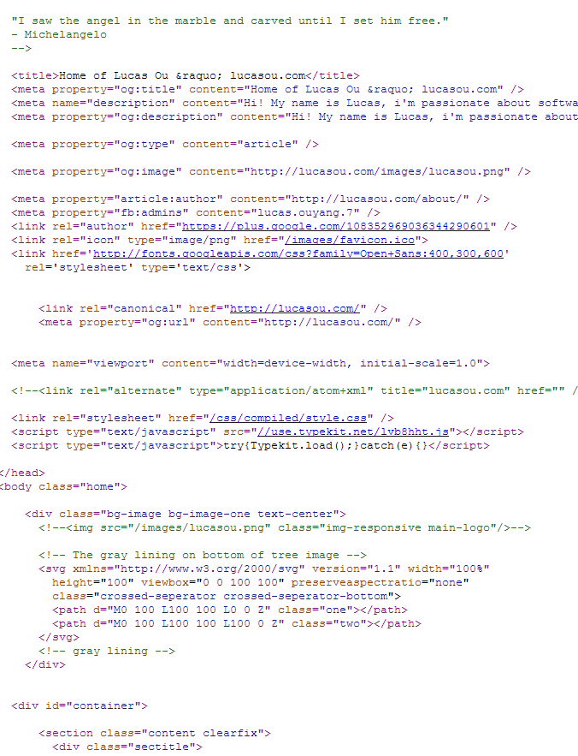
HTML
Stands for hyper Text Markup language.
Displays the “static "content on a webpage such as formatting, text, and images

Slide 7
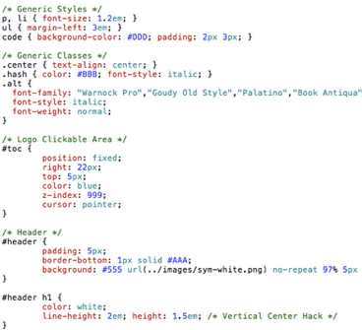
CSS
CSS: Cascading Sytle Sheets.
Changes how the “format” of the web page looks(font types/sizes, padding around elements, etc)

Slide 8

Javascript
A programming language that runs in your browser
Most “important” tool when hacking together webpages
Allows you to dynamically modify the webpage based on user actions

Slide 9
DOM
Basically the structure of a webpage’s HTML format
Turns HTML’s tags into an Tree-like object that can easily be referenced
Very similar to XML

Slide 10
Google Developer Console
You’re #1 tool for front-end web dev and hacking
Time for hands on stuff! :D
Feel free to follow along on your laptops
Topics:
Elements
Network
Console

Slide 11
Selenium
A great too for “web automation”
Can be used to fill in forms, scrape data, “click” on objects that require javascript to render, etc.
Better than most other web scrapping tools because it runs a full-fledged browser with JavaScript when automating
Can also cause it to be a lot slower too than a conventianal scrapper(don’t try spinning 1000x up on one machine!)

